Slide 1
Optimization of Efficient Transformer for High Resolution Images
Ankit Rajvanshi
ar7996
Gaurav Kuwar
gk2657

Slide 2
Executive Summary
Optimize High-resolution Convolutional Transformer (HCT) model by leveraging High-Performance Computing techniques.
By enhancing the efficiency and scalability of HCT, the project aims to enable faster and more effective processing of high-resolution images in applications such as medical imaging and satellite image analysis.
Notes:
Optimize High-resolution Convolutional Transformer
Enhanced efficiency and scalability of HCT model

Slide 3
Technical Challenges
The primary obstacle we encountered revolves around data scarcity. Existing datasets containing high-resolution images are notably limited in quantity, and those available offer only a sparse number of samples. This dearth of data presents a significant challenge, particularly when training transformer models, as the insufficiency of samples impedes the model's ability to generalize effectively.
Limited support in PyTorch for post training quantization.
Notes:
Hard to find datasets containing high-resolution images
and those available offer small number of samples
Lack of data makes it hard to generalize model effectively
Another, Limited Pytorch support for post training quantization

Slide 4
Approach
Processing high resolution images in neural networks is challenging not only because of the size of its dataset but also because of long range dependencies due to its large size.
Long range dependency has successfully been solved by HCT and to some extent it also solved the problem of size by reducing the quadratic time complexity of self - attention to linear via convolutional transformers.
Notes:
Ofcourse, Working with high results in a larged size dataset
Size of Dataset is not the only challenge,
Long range dependencies is another challenge
HCT model solves the problem of long range dependency.
And some extent solved problem of data size by reducing the quadratic time complexity of self - attention to linear via convolutional transformers

Slide 5
Approach
Now, to make HCT model viable in real world applications, we employed various techniques so that training and inference can be done efficiently.
Data Loading
To load the dataset efficiently, we used multiple I/O processes.
In context of PyTorch, we used value of num_workers equal to 2.
Notes:
To make the HCT model viable in real-world applications we employed various techniques to improve efficiency of training and inference time.
data loading - increased num of workers

Slide 6
Distributed Training
To reduce the training time, we employed data distributed training method across multiple GPUs within a single server.
In context of PyTorch, we used DistributedDataParallel with 4 GPUs as current HPC limit is max 4 GPUs.
Inference
To make inference faster we tried to compile the model using PyTorch’s tracing method.
It also made the HCT deployable on machines without python environment.
Quantized the model for faster inference on CPU, and decreased model size
Notes:
Reduced training time by data distributed training across multiple GPUs within a single server
For faster inference:
Compiled mode using Pytorch tracing methods.
And quantized model for faster inference on GPU and less model size
Made HCT deployable to machines w/o python environment

Slide 7
Implementation
Platform: NYU HPC
Framework: PyTorch
Dataset: https://structpku.github.io/LIU4K_Dataset/LIU4K_v2.html
ML Tools: Weight & Biases, PyTorch Profiler
Notes:
LIU4k dataset - consists of set of high resolution images divided into 4 categories.

Slide 8
Summary of Main Results
We were able to reduce the data loading time to ~271 secs per epoch from ~1000 secs per epoch.
Training time per epoch was reduced from ~160 secs to ~90 secs
Running time per epoch was reduced from ~1170 secs to ~360 secs.
We also successfully deployed the model using C++.
Successfully quantized the model for inference on CPU.

Slide 9

Experimental Evaluation
We experimented the training process with various values of hyper parameters.
We tried various final resolution of image before feeding to model and finally got the best result with accuracy and time-tradeoff at 4000x4000 pixels which is high enough to make it High Resolution images. Moreover, we can not resize it directly in order to maintain aspect ratio since all images were of different resolution
Final Transformation Applied:

Slide 10
As per original paper, value of batch size was chosen as 32 but due to bigger image in our experiment, we need to reduce batch size to 16 due to GPU memory constraint.
With above values, we were able to reach training accuracy of 67% and validation accuracy of 55% with single GPU in 30 epochs (~12 hours). Low accuracy is mainly due to lack of data.
During distributed training with 4 GPUs, we tried with and without learning rate annealing schedule and we found that annealing schedule helps in achieving more consistent results on validation dataset.

Slide 11
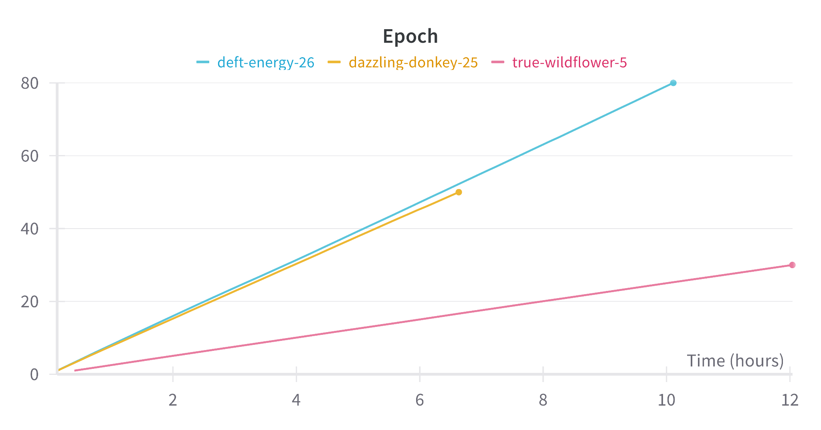
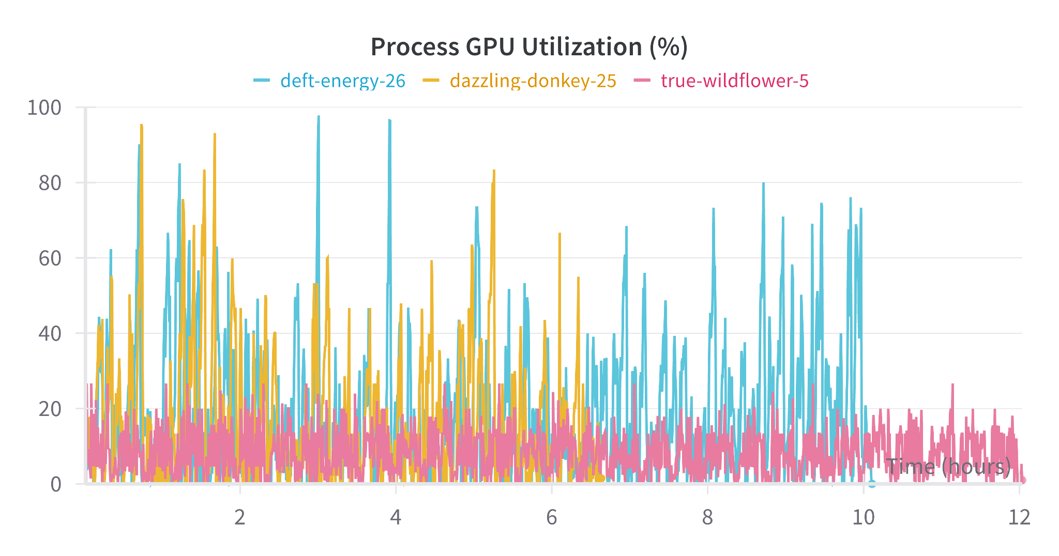
Distributed with learning rate Annealing
Distributed w/o learning rate Annealing
Single GPU
Also we can see that with distributed training, GPU utilization was also increased.

Slide 12
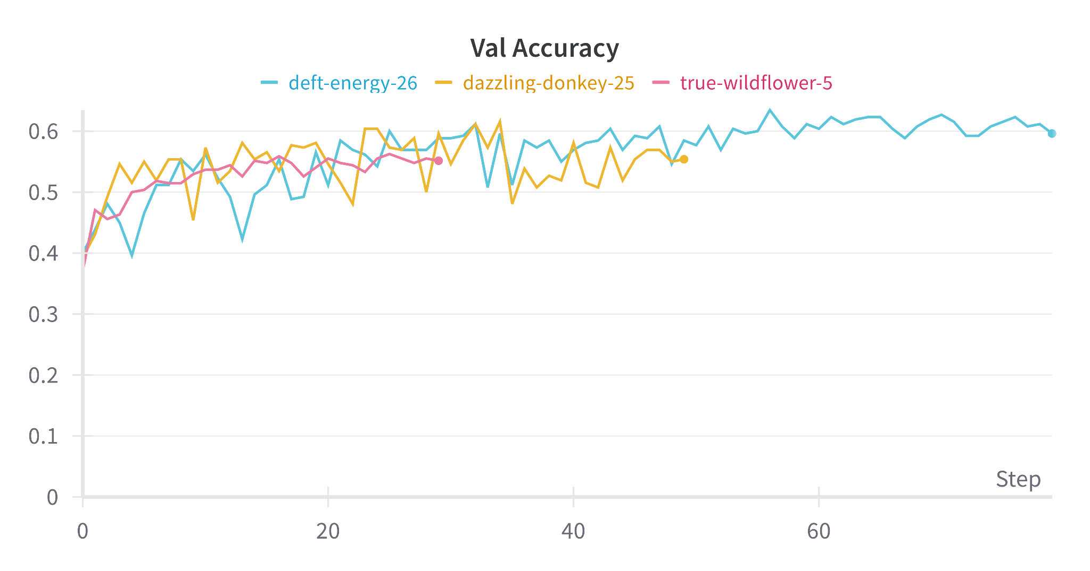
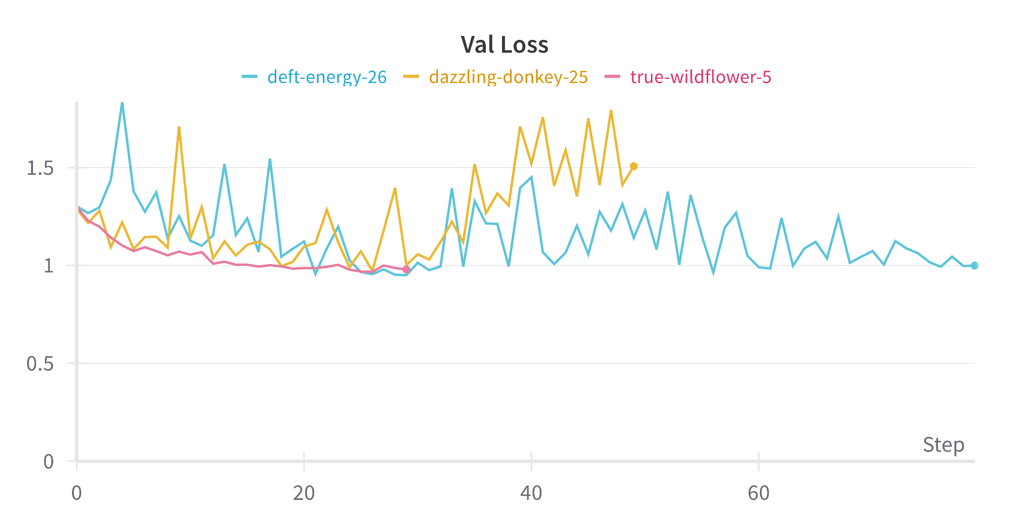
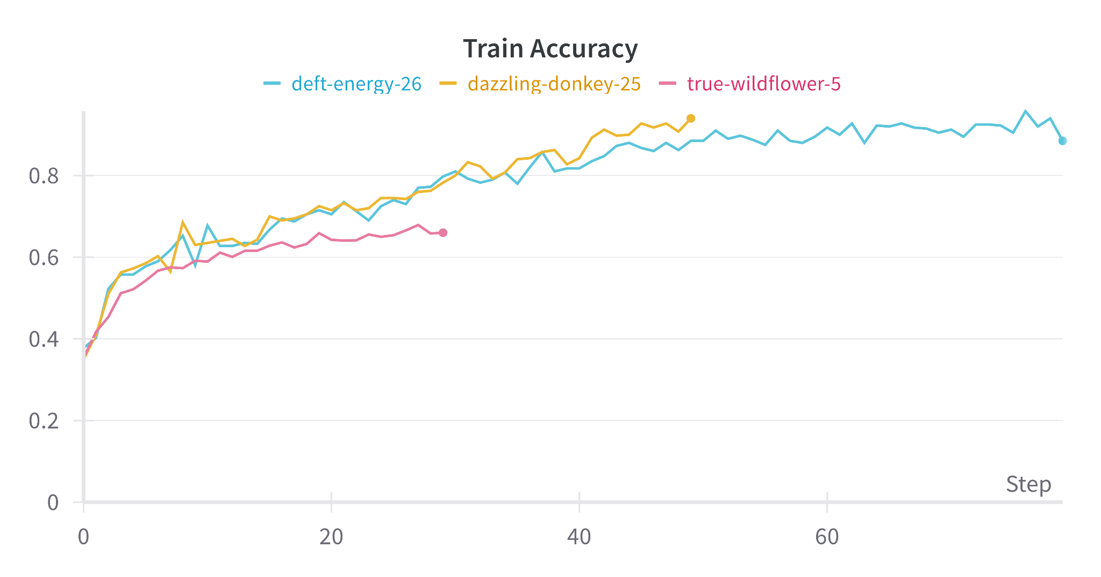
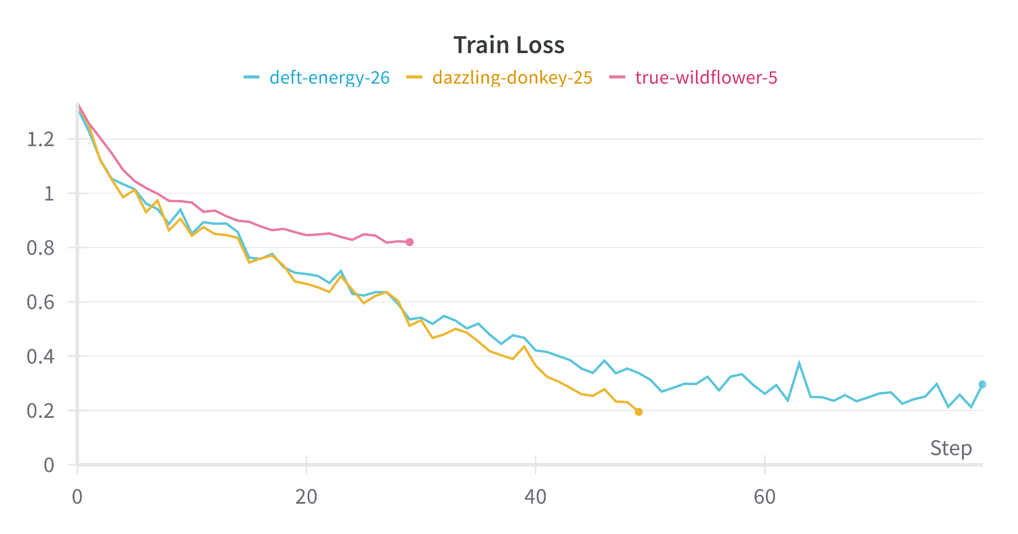

Slide 13
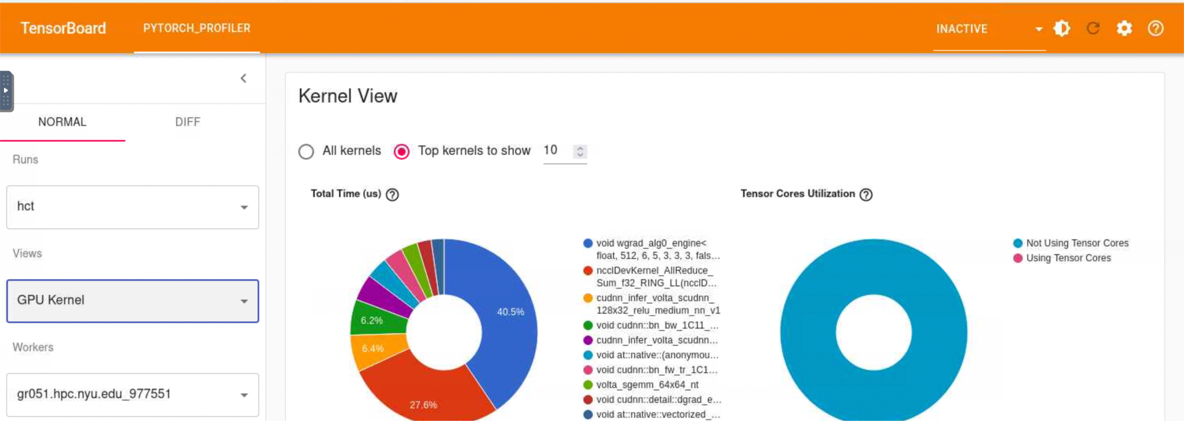
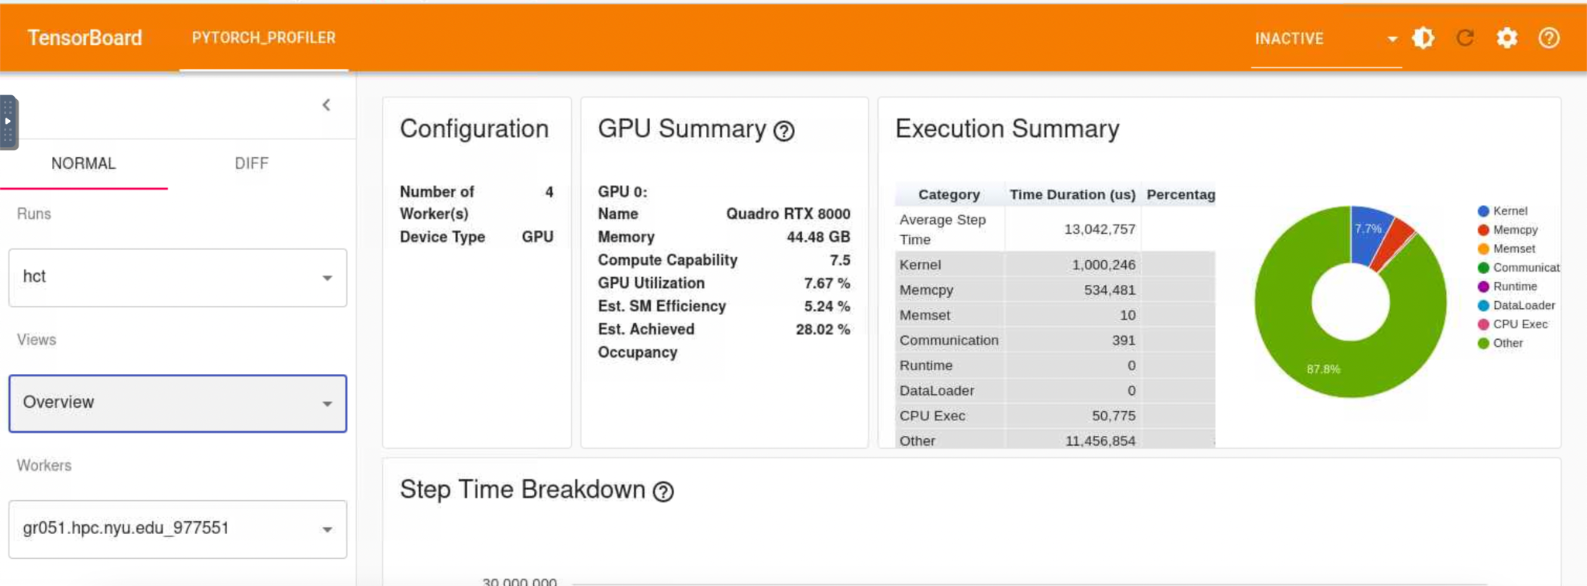

Slide 14
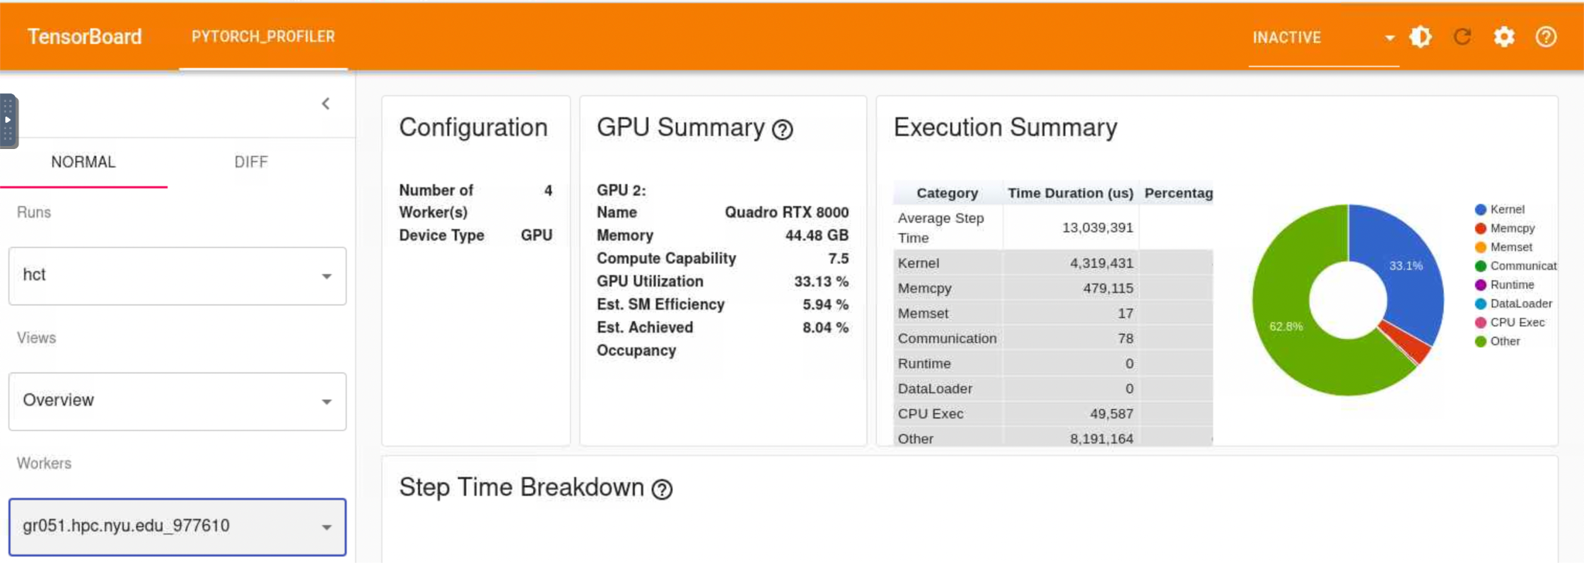
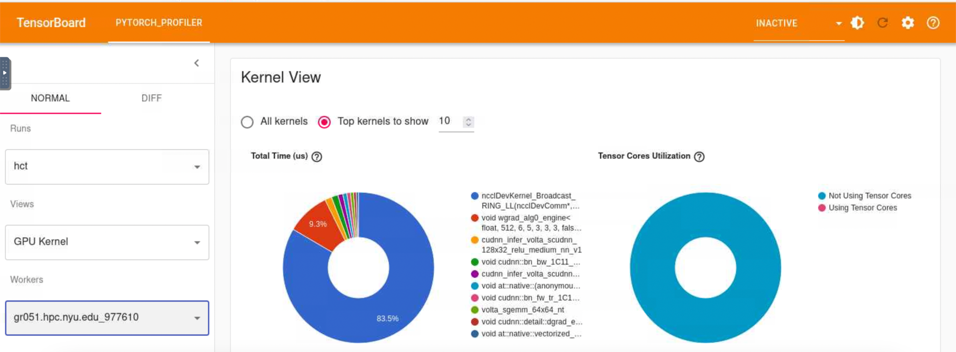

Slide 15
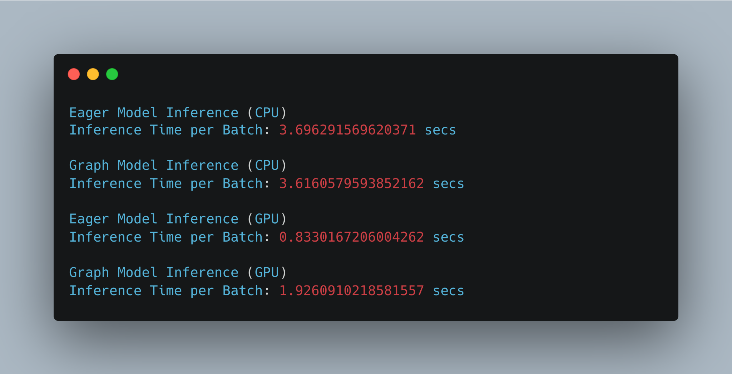
Batch Size: 16
Num_workers: 0
Num GPUs: 1
CPU cores: 16
RAM: 128 GB
Environment: Python
For inferencing, we were able to achieve a speed of 1.02 with the help of Torchscript on CPU.

Slide 16
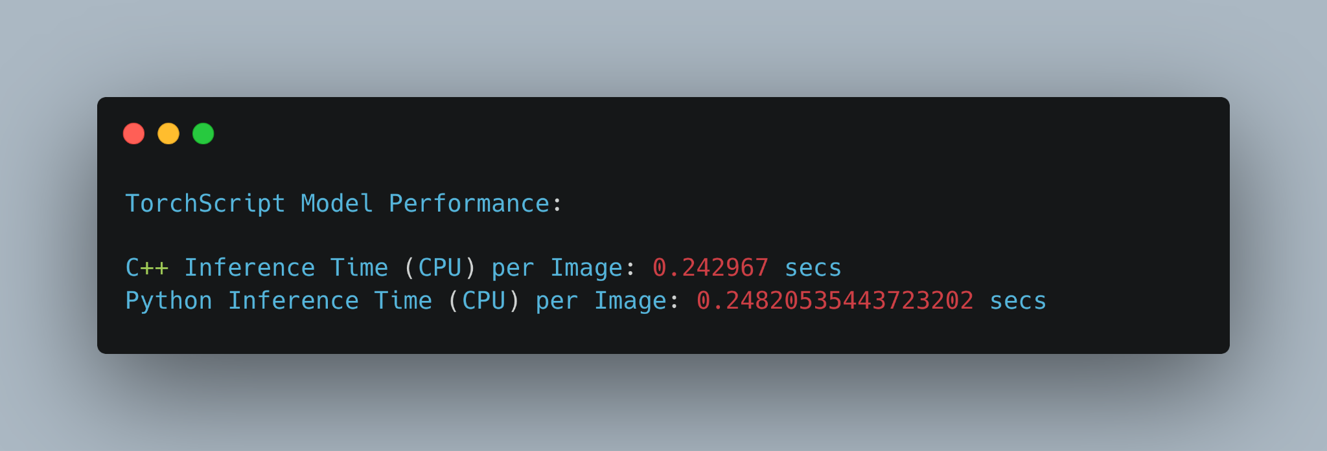

If we compare the TorchScript model on python and C++, performance is similar.

Slide 17
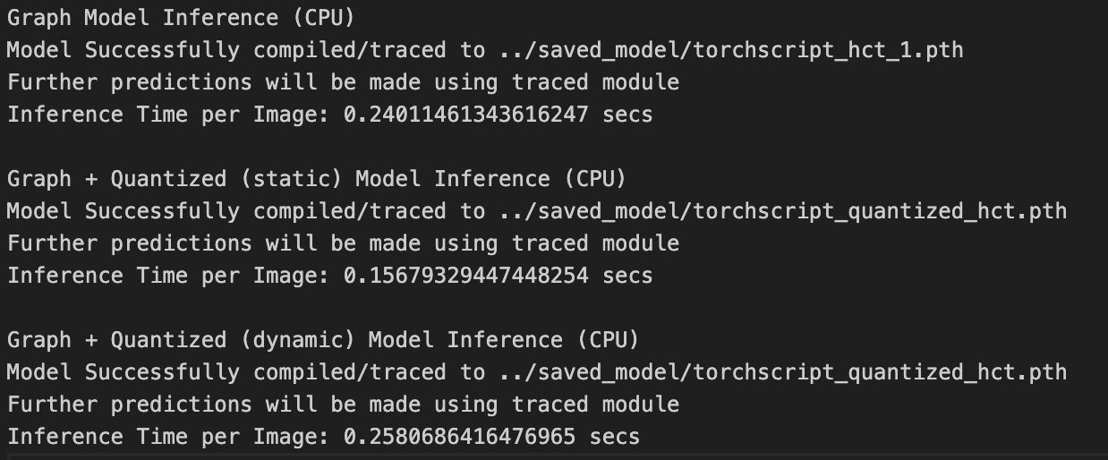
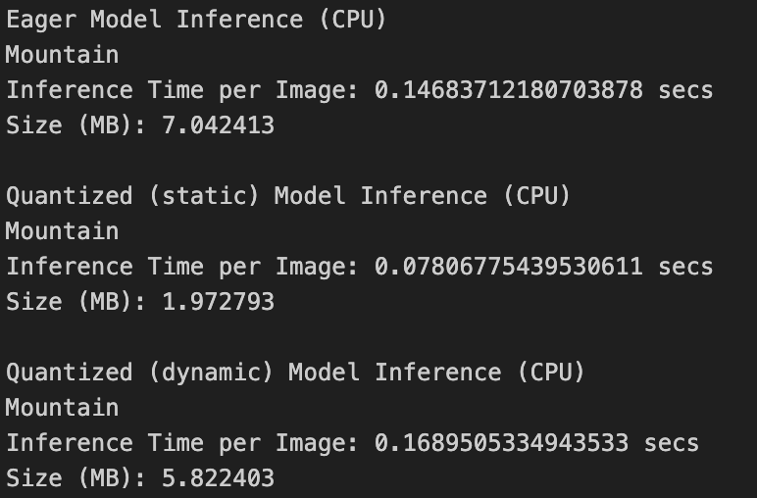
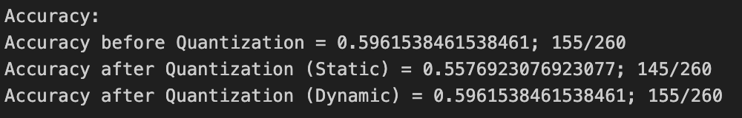
Quantization Key observations
Static quantization: large reduction of model size, and inference time, but reduced accuracy.
Dynamic quantization retains accuracy, but small reduction in model size, and inference time is same as unquantized.
Graph mode is generally slower than eager mode.

Slide 18
Conclusion and Observations
With distributed training using 4 GPUs, we observed that we were able to achieve overall speedup of 3.25 over single GPU.
Model was successfully traced using torch.jit.trace()
Efficiency of inference of Single image is better on CPU in comparison with GPU using TorchScripted model.
Quantized (static) the model resulting in 71.9% decreased model size, and 1.9x better inference time, but 3.8% loss in accuracy.

Slide 19
GitHub Repo
https://github.com/sudoDollar/OptimizedHCT
Wandb Link:
https://wandb.ai/ar7996/HCT

